Slide 1
Blacktown Chinese Christian Church
Welcome to Our English Service 05.10.2025
English Service 9:45 – 11:00 am
Worship Songs: Passage: Speaker: Topic: Response Song: Announcements and Closing Prayer Benediction
Diamonds Shout To The Lord 1 Peter 2:1-10 Combined Service (Xavier) God's Newborn Babies TBA

Slide 2
BCCC english service

Slide 3

Please keep all phones on silent

Slide 4
Diamonds
钻石
CCLI Licence No: 5485849
CCLI许可证号：5485849

Slide 5
Here and now I'm in the fire
此刻身在火中

Slide 6
In above my head
火焰在我头顶

Slide 7
(Oh-oh-oh-oh-oh-oh-oh-oh)
(噢-噢-噢-噢-噢-噢-噢-噢)

Slide 8
Being held under the pressure

Slide 9
重压之下我被困
Don't know what'll be left

Slide 10
不知剩下什么
(Oh-oh-oh-oh-oh-oh-oh-oh)

Slide 11
(噢-噢-噢-噢-噢-噢-噢-噢)
But it's here in the ashes

Slide 12
就在灰烬里我
I'm finding treasure

Slide 13
我寻到了珍宝
He's making diamonds, diamonds

Slide 14
祂造出钻石，钻石
Making diamonds out of dust

Slide 15
从尘土造出钻石
He is refining and in His timing

Slide 16
祂在提炼，按祂时候
He's making diamonds out of us

Slide 17
从我们造出钻石
I'll surrender to the power of being crushed by love

Slide 18
我降服于爱压碎我的能力
(Oh-oh-oh-oh-oh-oh-oh-oh)

Slide 19
(噢-噢-噢-噢-噢-噢-噢-噢)
'Til the beauty that was hidden

Slide 20
直到被藏的美丽
Isn't covered up

Slide 21
不再被遮盖
(Oh-oh-oh-oh-oh-oh-oh-oh)

Slide 22
(噢-噢-噢-噢-噢-噢-噢-噢)
Oh it's not what I hoped for

Slide 23
噢这不是我所望
It's something much better

Slide 24
它好过我所求
He's making diamonds, diamonds

Slide 25
祂造出钻石，钻石
Making diamonds out of dust

Slide 26
从尘土造出钻石
He is refining and in His timing

Slide 27
祂在提炼，按祂时候
He's making diamonds out of us

Slide 28
从我们造出钻石
Oh the joy of the Lord

Slide 29
噢主我的喜乐
It will be my strength

Slide 30
它将是我力量
When the pressure is on

Slide 31
当重压来临时
He's making diamonds

Slide 32
祂造出钻石
Oh the joy of the Lord

Slide 33
噢主我的喜乐
It will be my strength

Slide 34
它将是我力量
When the pressure is on

Slide 35
当重压来临时
He's making, he's making

Slide 36
祂正在造，祂正在造
He's making diamonds, diamonds

Slide 37
祂造出钻石，钻石
Making diamonds out of dust

Slide 38
从尘土造出钻石

Slide 39
He is refining and in His timing
祂在提炼，按祂时候

Slide 40
He's making diamonds out of dust
祂从尘土造钻石

Slide 41
He's making diamonds out of us
祂从我们造钻石

Slide 42
I won't be afraid to shine
我将不惧怕发光

Slide 43
I won't be afraid to shine
我将不惧怕发光

Slide 44
I won't be afraid to shine
我将不惧怕发光

Slide 45
'Cause he's making diamonds out of dust
因祂从尘土造出钻石

Slide 46
Making diamonds out of us
从我们造出钻石

Slide 47
Shout To The Lord
向主喊
CCLI Licence No: 5485849
CCLI许可证号：5485849

Slide 48
My Jesus, my Saviour
我耶稣，我救主

Slide 49
Lord there is none like You
主无人能像你

Slide 50
All of my days I want to praise
我一生年日要赞美

Slide 51
The wonders of Your mighty love
你奇妙大爱真伟大

Slide 52
My comfort, my shelter
我安慰，我居所

Slide 53
Tower of refuge and strength
避难所，我力量真

Slide 54
Let every breath, all that I am
我每一气息，我一切

Slide 55
Never cease to worship You
永不止息敬拜你

Slide 56
Shout to the Lord all the Earth, let us sing
向主欢呼，全地来歌唱吧

Slide 57
Power and majesty, praise to the King
权能和威严，赞美我君王

Slide 58
Mountains bow down and the seas will roar
群山要跪拜，大海会怒吼

Slide 59
At the sound of Your name
在你圣名声中

Slide 60
I sing for joy at the work of Your hands
我欢唱因你手所创造

Slide 61
Forever I'll love You, forever I'll stand
我永远爱你，我永远站立

Slide 62
Nothing compares to the promise I have
无物能与你宝贵应许比

Slide 63
In You
在你

Slide 64
My Jesus, my Saviour
我耶稣，我救主

Slide 65
Lord there is none like You
主无人能像你

Slide 66
All of my days I want to praise
我一生年日要赞美

Slide 67
The wonders of Your mighty love
你奇妙大爱真伟大

Slide 68
My comfort, my shelter
我安慰，我居所

Slide 69
Tower of refuge and strength
避难所，我力量真

Slide 70
Let every breath, all that I am
我每一气息，我一切

Slide 71
Never cease to worship You
永不止息敬拜你

Slide 72
Shout to the Lord all the Earth, let us sing
向主欢呼，全地来歌唱吧

Slide 73
Power and majesty, praise to the King
权能和威严，赞美我君王

Slide 74
Mountains bow down and the seas will roar
群山要跪拜，大海会怒吼

Slide 75
At the sound of Your name
在你圣名声中

Slide 76
I sing for joy at the work of Your hands
我欢唱因你手所创造

Slide 77
Forever I'll love You, forever I'll stand
我永远爱你，我永远站立

Slide 78
Nothing compares to the promise I have
无物能与你宝贵应许比

Slide 79
In You
在你

Slide 80
Shout to the Lord all the Earth, let us sing
向主欢呼，全地来歌唱吧

Slide 81
Power and majesty, praise to the King
权能和威严，赞美我君王

Slide 82
Mountains bow down and the seas will roar
群山要跪拜，大海会怒吼

Slide 83
At the sound of Your name
在你圣名声中

Slide 84
I sing for joy at the work of Your hands
我欢唱因你手所创造

Slide 85
Forever I'll love You, forever I'll stand
我永远爱你，我永远站立

Slide 86
Nothing compares to the promise I have
无物能与你宝贵应许比

Slide 87
In You
在你

Slide 88
Nothing compares to the promise I have
无物能与你宝贵应许比

Slide 89
In You
在你

Slide 90
Nothing compares to the promise I have
无物能与你宝贵应许比

Slide 91
In You
在你

Slide 92
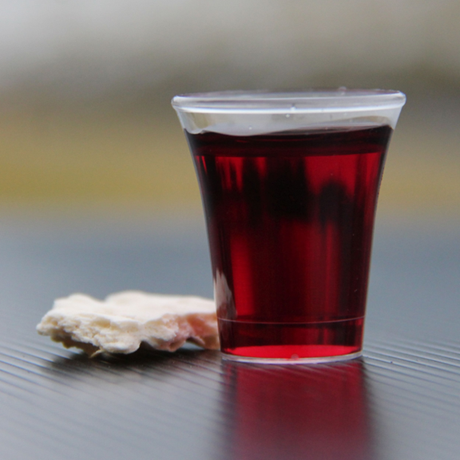
Holy Communion

Slide 93

Bible reading

Slide 94
1 Peter 2:1-10
Therefore, rid yourselves of all malice and all deceit, hypocrisy, envy, and slander of every kind. ² Like newborn babies, crave pure spiritual milk, so that by it you may grow up in your salvation,

Slide 95
1 Peter 2:1-10
³ now that you have tasted that the Lord is good.
⁴ As you come to him, the living Stone—rejected by humans but chosen by God and precious to him—

Slide 96
1 Peter 2:1-10
⁵ you also, like living stones, are being built into a spiritual house to be a holy priesthood, offering spiritual sacrifices acceptable to God through Jesus Christ. ⁶ For in Scripture it says:
“See, I lay a stone in Zion,
a chosen and precious cornerstone,
and the one who trusts in him
will never be put to shame.”

Slide 97
1 Peter 2:1-10
⁷ Now to you who believe, this stone is precious. But to those who do not believe,
“The stone the builders rejected
has become the cornerstone,”
⁸ and,
“A stone that causes people to stumble
and a rock that makes them fall.”
They stumble because they disobey the message—which is also what they were destined for.

Slide 98
1 Peter 2:1-10
⁹ But you are a chosen people, a royal priesthood, a holy nation, God’s special possession, that you may declare the praises of him who called you out of darkness into his wonderful light. ¹⁰ Once you were not a people, but now you are the people of God; once you had not received mercy, but now you have received mercy.

Slide 99
Announcements

Slide 100





Account name: Blacktown Chinese Christian Church
Account number: 4216 50263
Offering
BSB: 112 - 879
Please put in "offering" as the reference
The offering box is available at the back of the hall

Slide 101
Prayer points

Slide 102
Mingle time!

